Slide 1





?

Slide 2




Slide 3

Dirty read
Repeatable read
Phantom
READ UNCOMMITED
READ COMMITED
REPEATABLE READS
SERIALIZABLE

Slide 4





A
A
Balance | Rowversion
100 | 1
Balance | Rowversion
100 | 1
Balance | Rowversion
120 | 1
Balance | Rowversion
120 | 2
B
B
1 = 2
Balance | Rowversion
100 | 1
Balance | Rowversion
80 | 1
A
1 = 1
Balance | Rowversion
120 | 1
Balance | Rowversion
100 | 1
B
Balance | Rowversion
80 | 1
Optimistic
Pesimistic

Slide 5
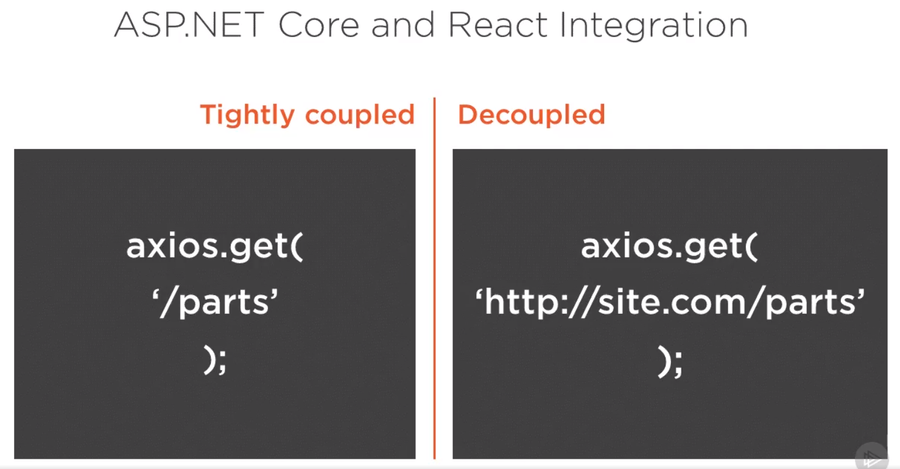

Slide 6





React + ASP.NET – Tightly coupled

Slide 7

React + ASP.NET - Decoupled
express.js

Slide 8
IISNode
0.2.21
URL Rewrite
Node
6.9.5

Slide 9
